Slide 1
Magnetism
Matteo Curti
Oliver Chapman
Iasmina Leagan
Omar Latreche
Joshua Feria De La Torrie

Slide 2
REPOSITORY DIRECTORY
Host Domain - https://dev.azure.com/Group3-FinalProject/
Personal Accesso Token - 7dbfqm2fohj7fvrpfgetdclntlgla7njbwzixj2fp7jy4zlkfqja
Repository to Clone – MagnetMechanicsTPREPO
Moodle project uploaded by: Iasmina Leagan
If the token doesn’t work you can re-create another one from AzuraDevops

Slide 3
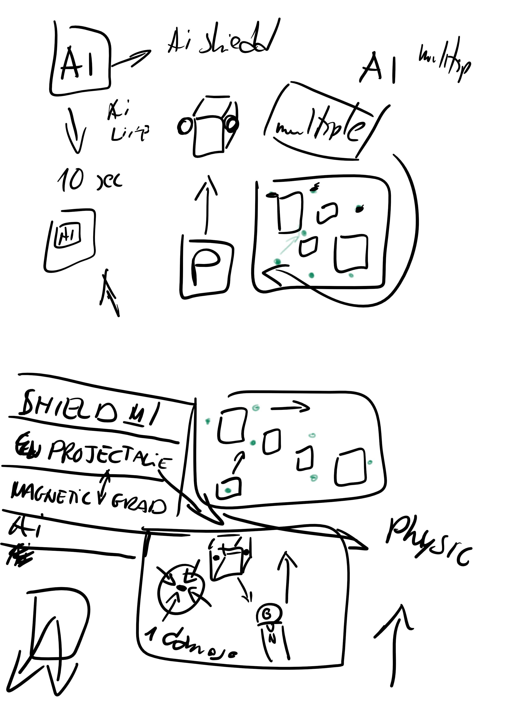
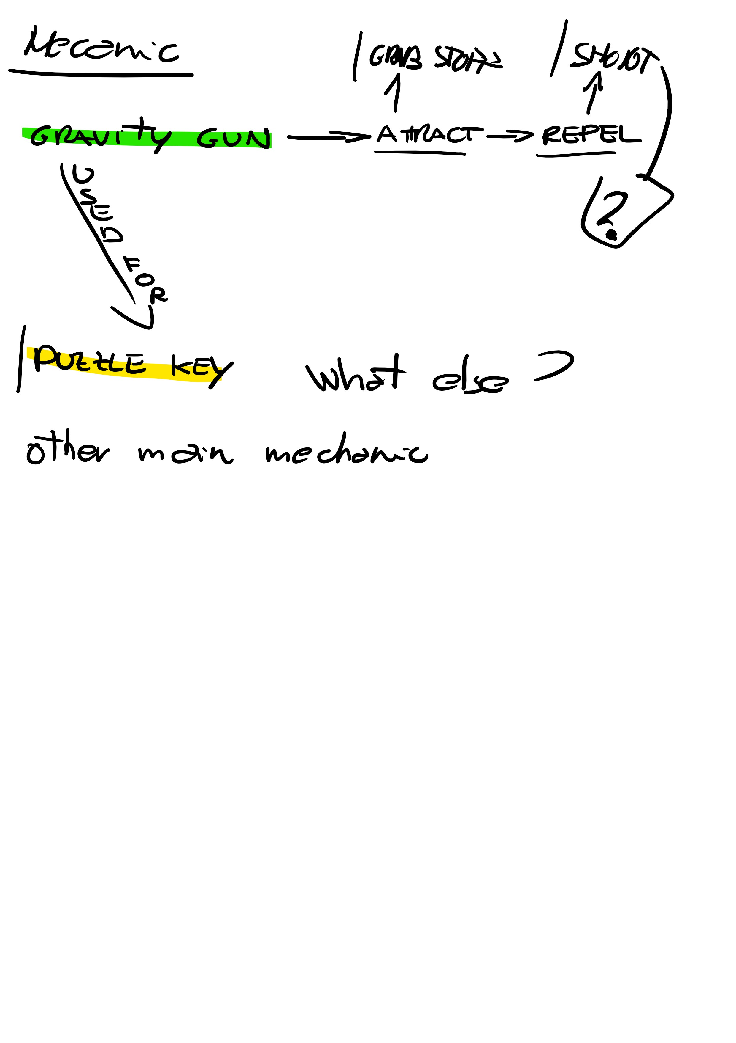
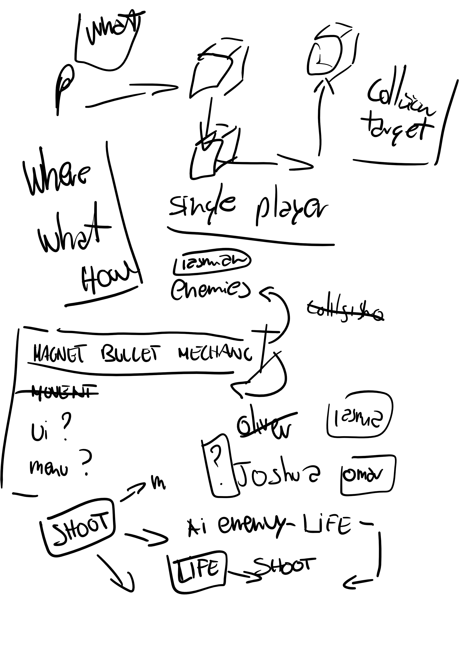
The first idea

Slide 4
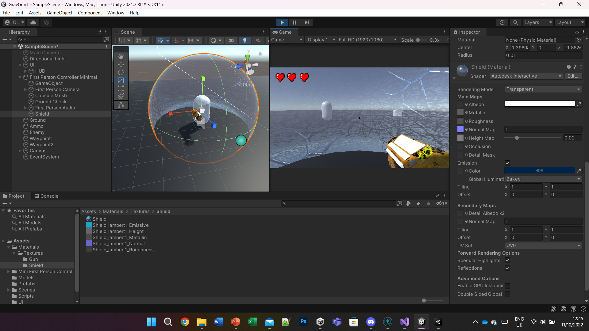
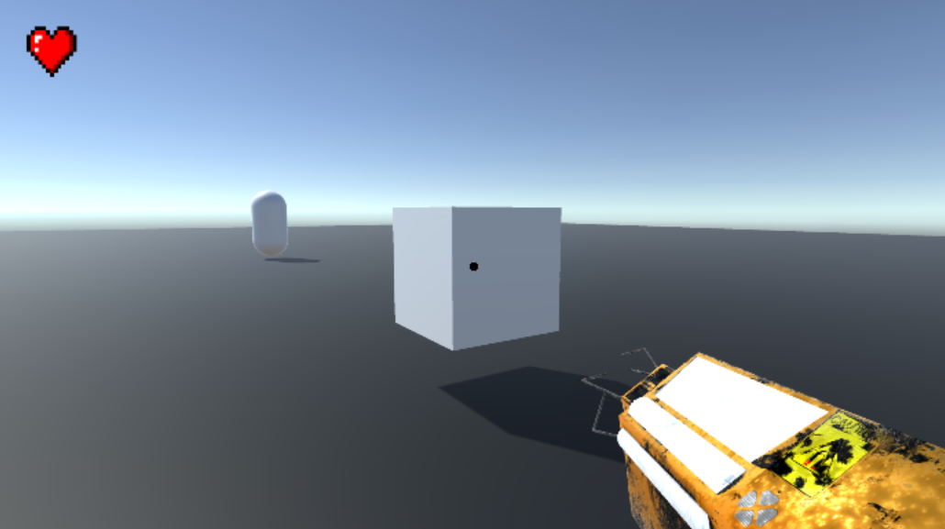
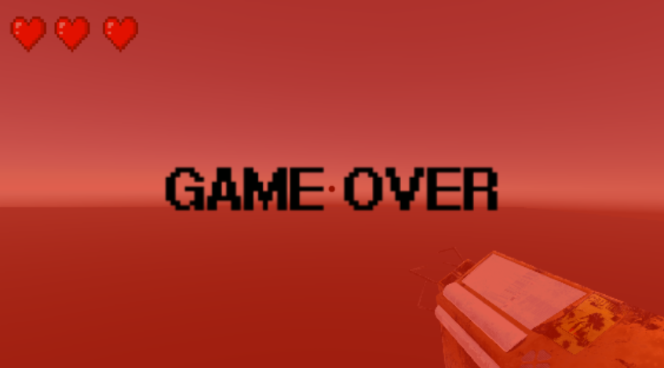
First Development in Unity

Slide 5


The changes throughout the development
Gameplay Changes

Slide 6

DEMO

Slide 7
The Group Specialism
Matteo Curti
Oliver Chapman
Iasmina Leagan
Omar Latreche
Joshua Feria De La Torrie
Accessibility
Physics
Networking
User Interface
Optimization

Slide 8
Matteo Curti
Accessibility

Slide 9
Specialism Implementations
ACCESSIBILITY MENU:
Re-mappable controls system, with mouse sensibility.
Invertible camera inputs.
Colour Blindness functionality with multiple types of variation and the severity level of the colour blindness.
Save and Load the system for the Accessibility Menu.
Helped with the scoring system.

Slide 10
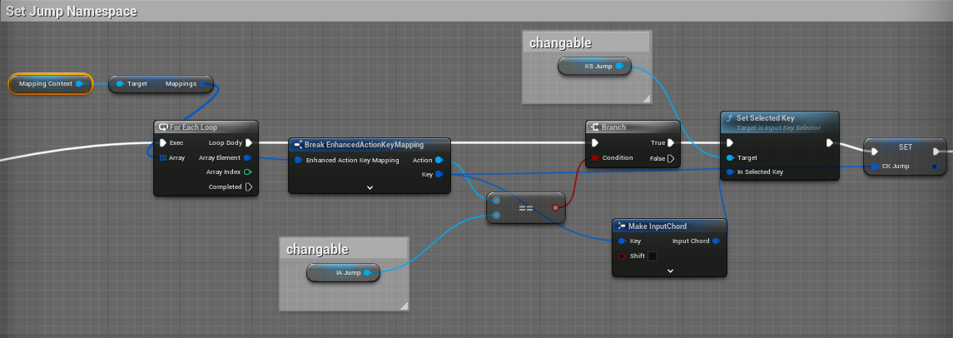
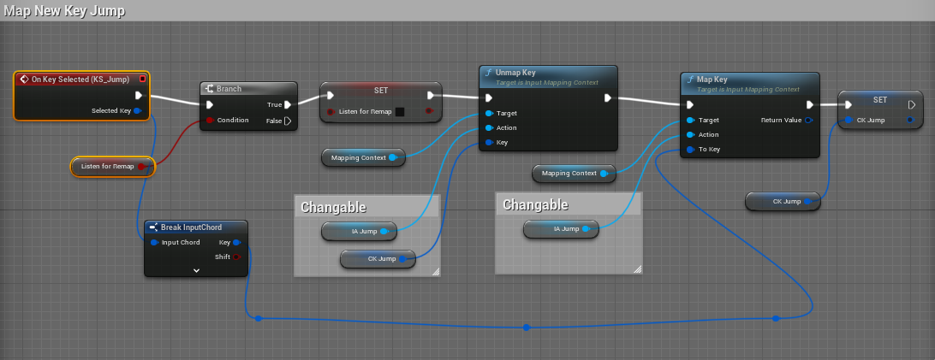
Re-mappable Controls

Slide 11
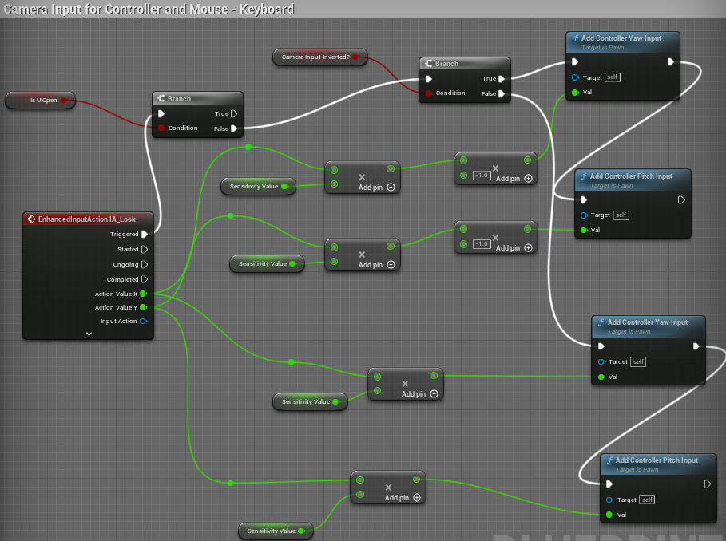
Camera Sensibility and Inverted Camera

Slide 12
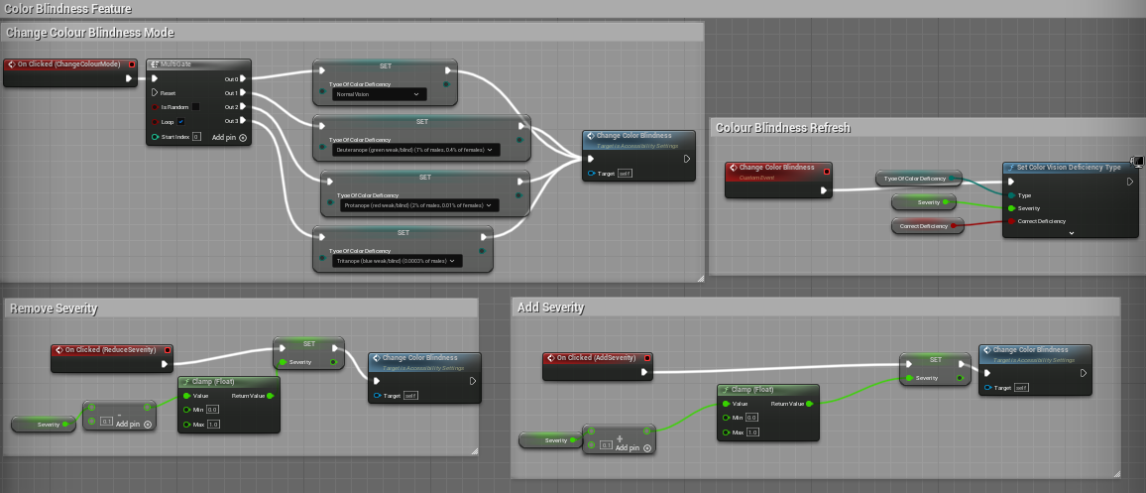
Colour Blindness

Slide 13
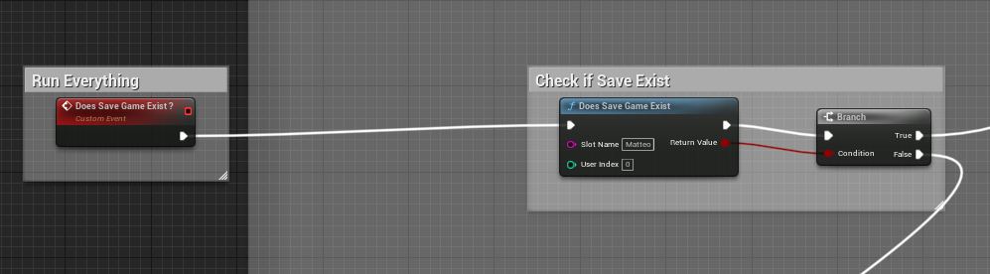
Save and Load System

Slide 14
Generalism Implementations
Modelled and Textured all the assets in the environment.
Developed the movement script for the character and all the new inputs with Mouse & Keyboard, and Controller.
Developed a script to give each Player a different Colour when spawned.
Developed Rotating Planet (Not the Textures).
Postprocessing ( Skybox, Lighting).
All the character animations.

Slide 15
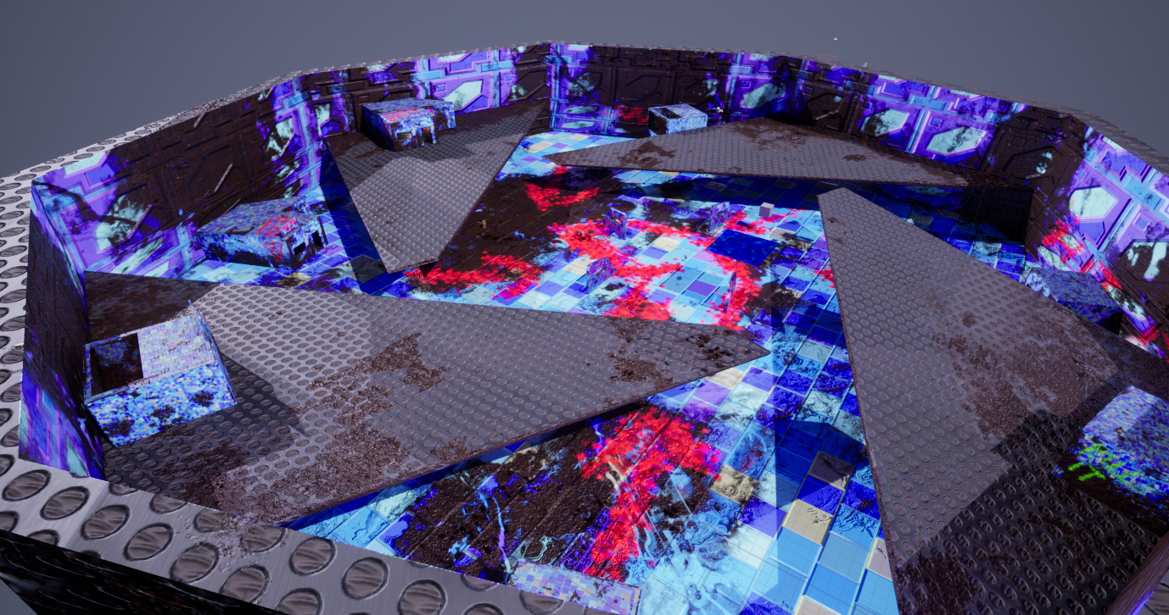
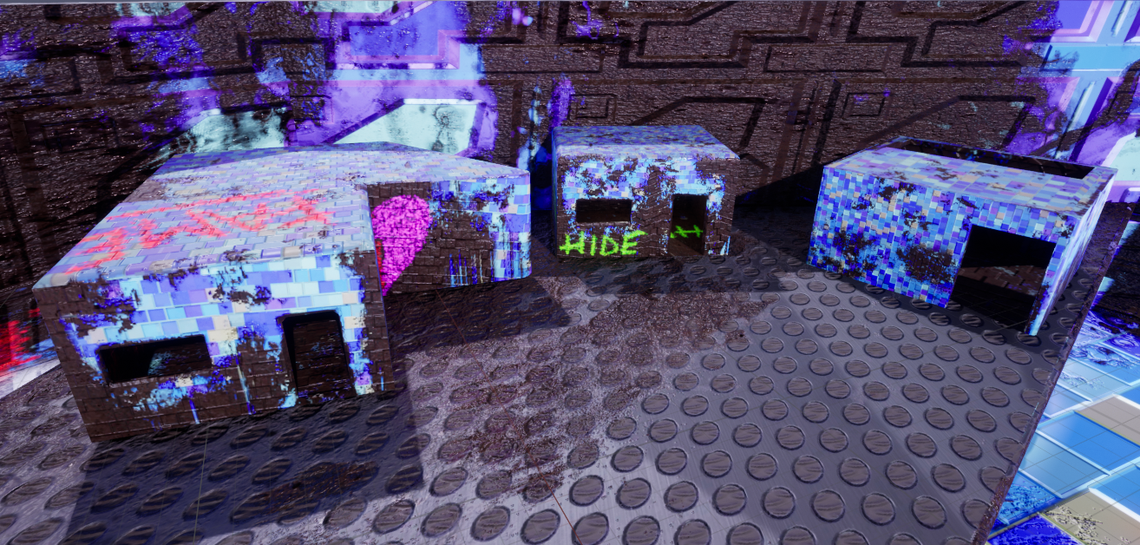
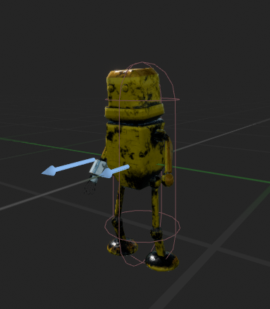
Environment Modelling and Texturing

Slide 16
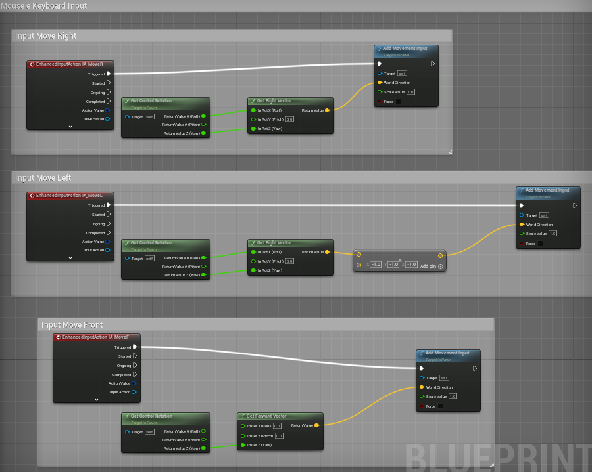
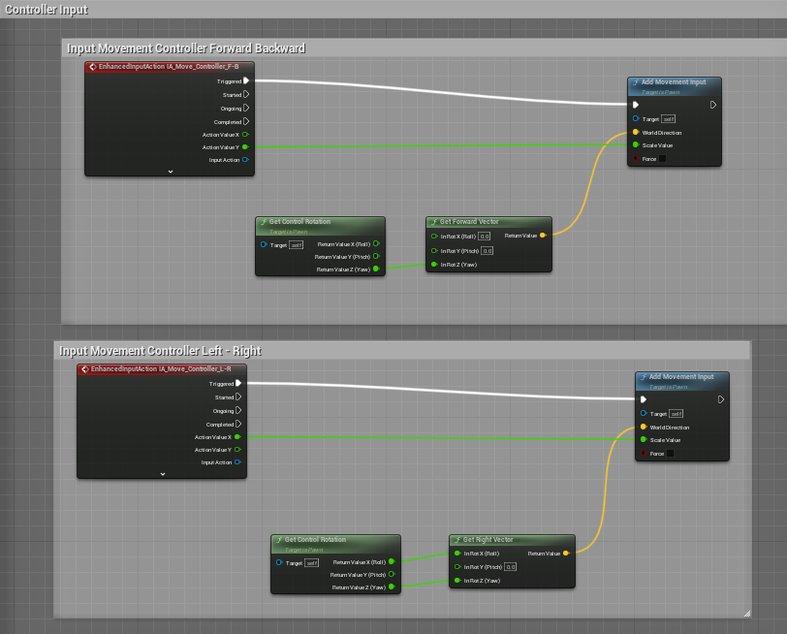
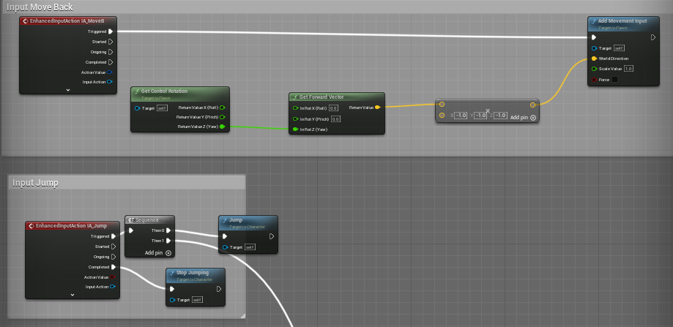
Movement Scripts

Slide 17
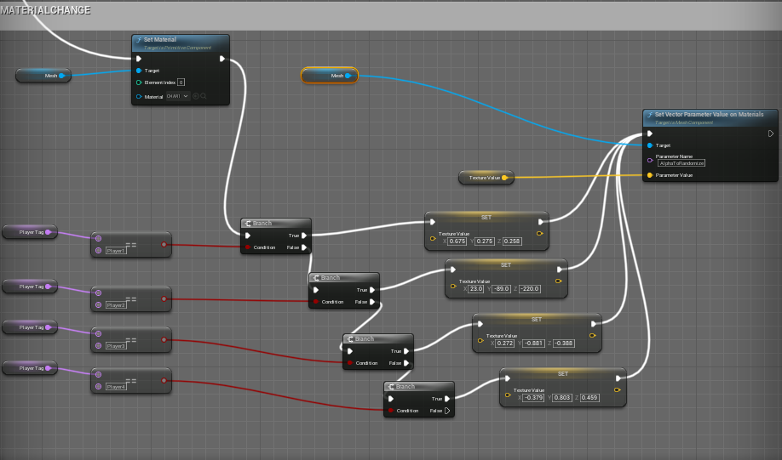
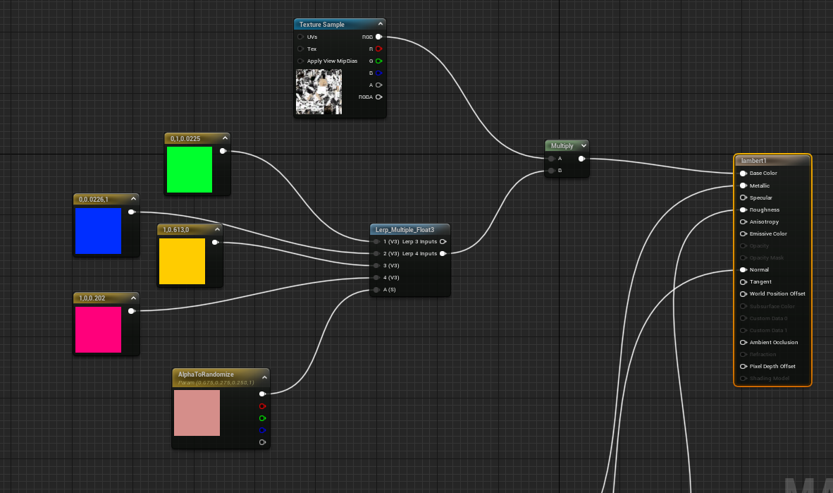
Change Texture Colour depending on the Character

Slide 18
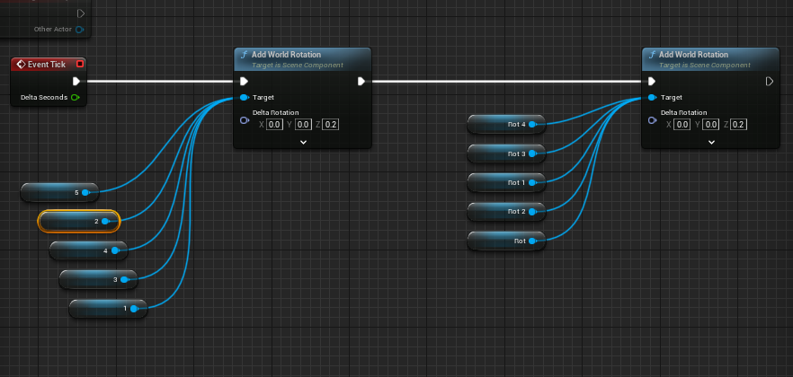
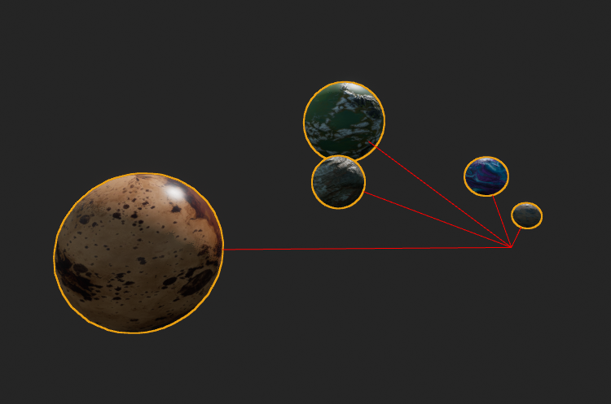
Rotating Planets

Slide 19
Oliver Chapman
Physics

Slide 20
Specialism Implementations
Character Movement
Characters with more advanced movement mechanics
Double Jump
Wall Running
Physics Mechanics
Gravity Gun
Rope Bridge

Slide 21
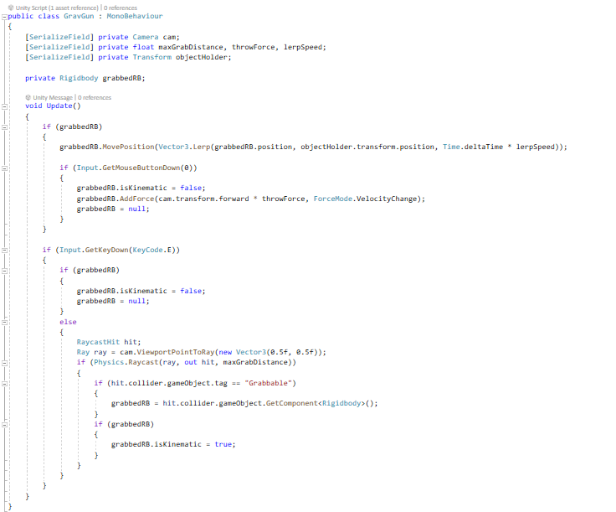
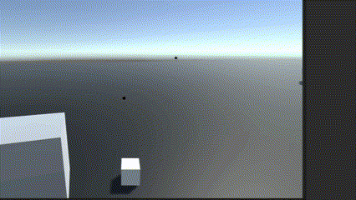
Original Version
Built in Unity

Slide 22
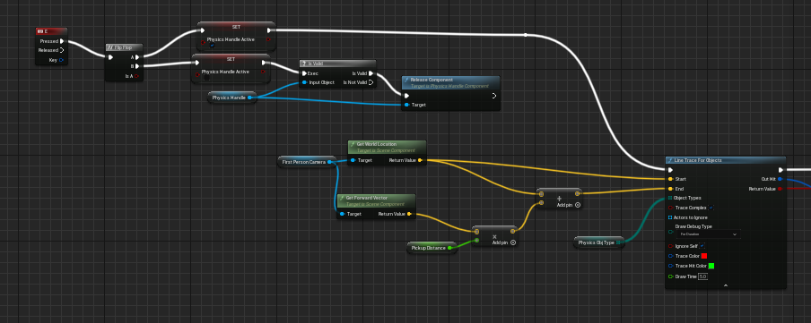
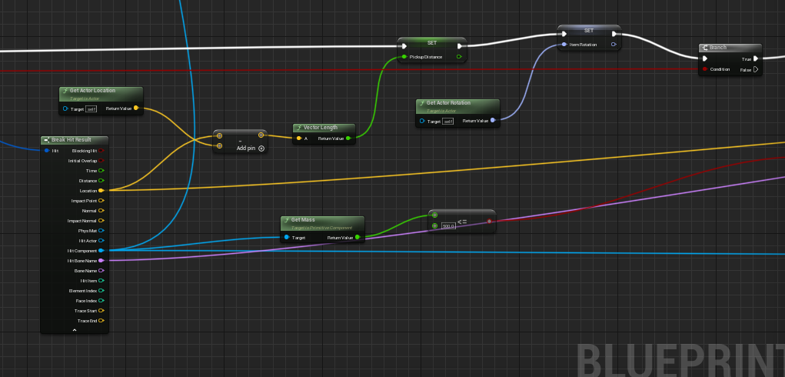
Initial Development – Gravity Gun V2

Slide 23
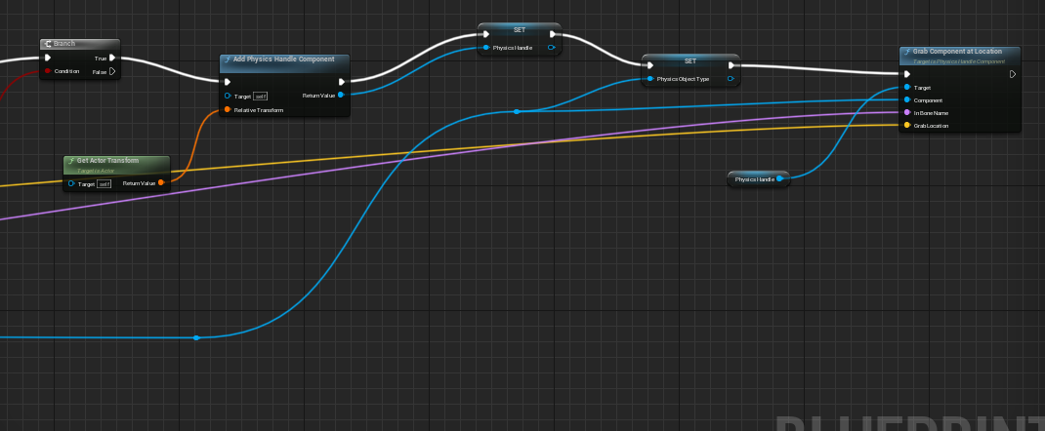
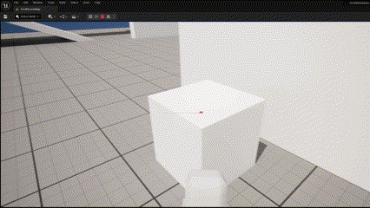
Initial Development – Gravity Gun V2

Slide 24
Character Movement Key Points
Advanced character movement can make players feel more connected to their in-game avatar, allowing them to inhabit the game world. Fluid movement can help create a sense of realism and can make players feel as though they are truly controlling the character.
Advanced movement mechanics can open up new avenues for gameplay, such as allowing players to explore previously unreachable areas or to access hidden items or secrets.
In multiplayer games players who have mastered advanced movement mechanics can gain an edge over their opponents, allowing them to out maneuverer and outplay them.

Slide 25
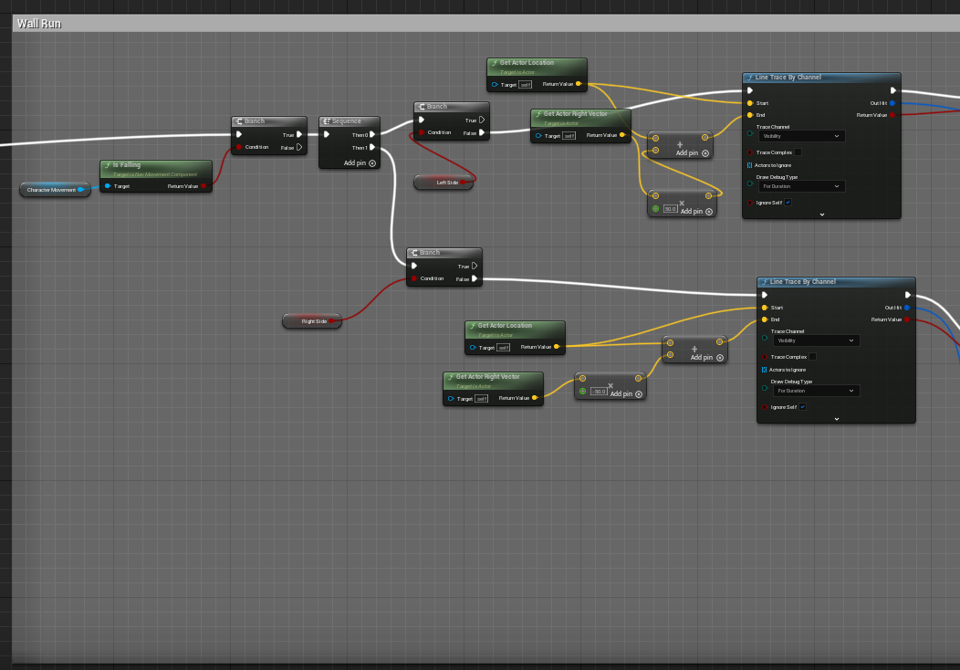
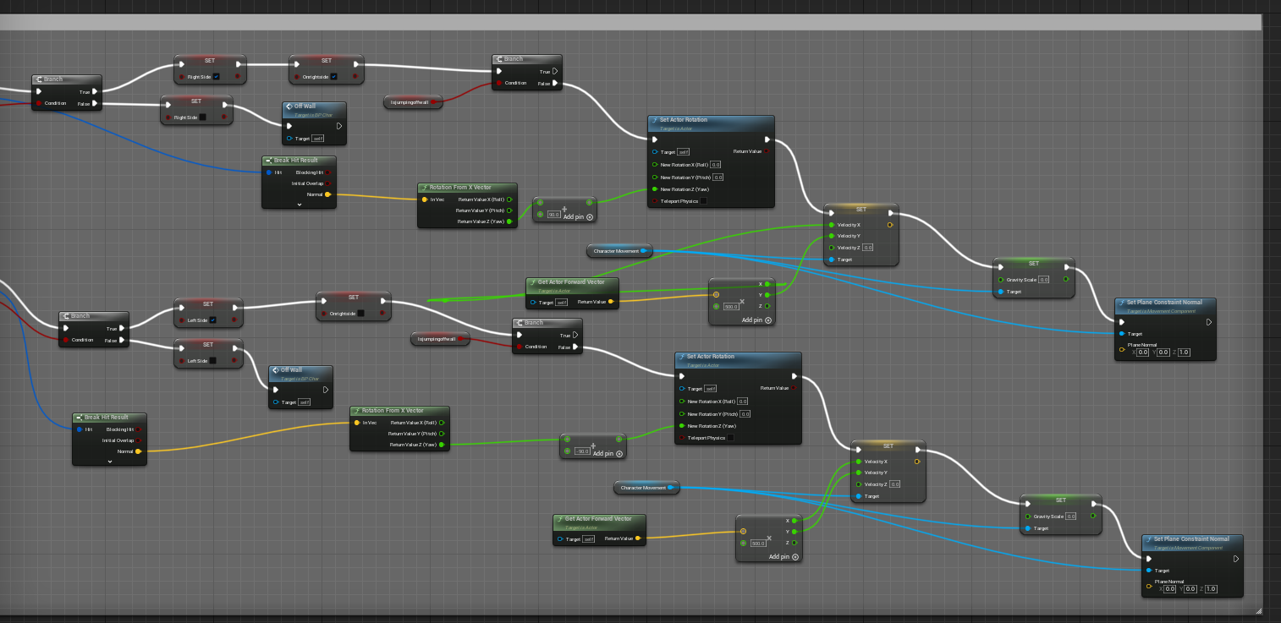
Wall Running

Slide 26
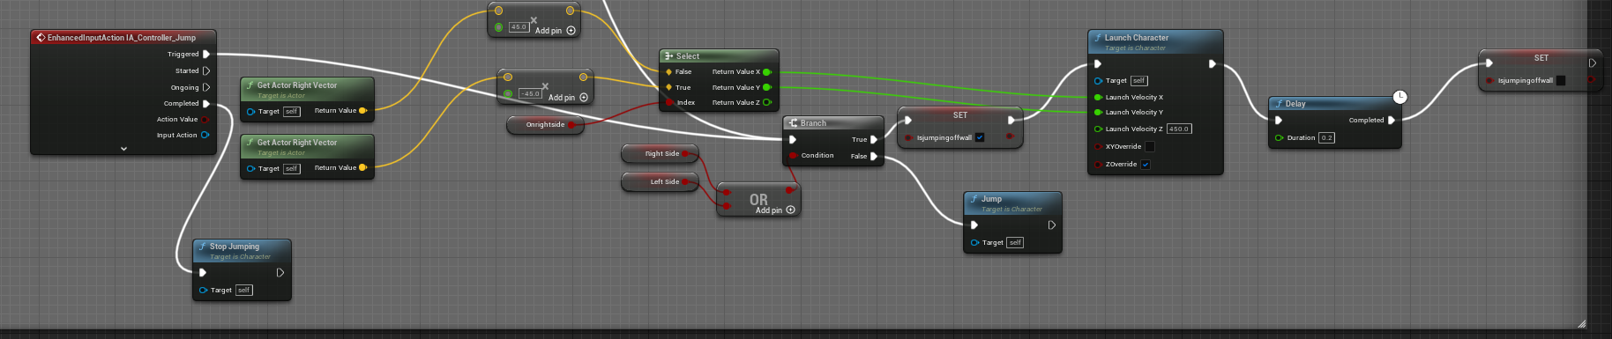
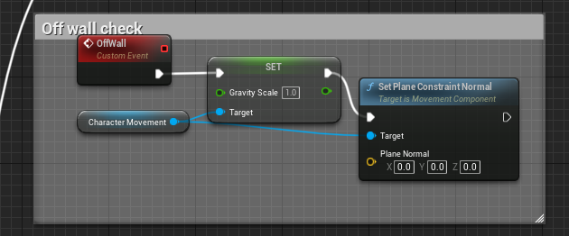
Wall Running – Jump off Wall

Slide 27
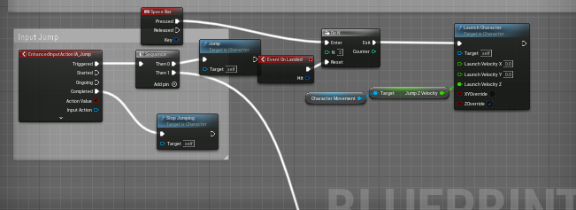
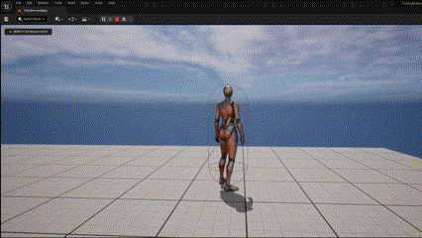
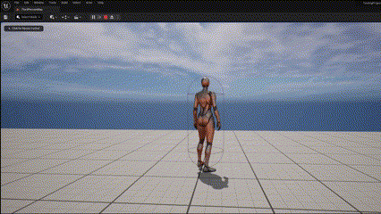
Advanced Character Movement
Double Jump / Crouching

Slide 28
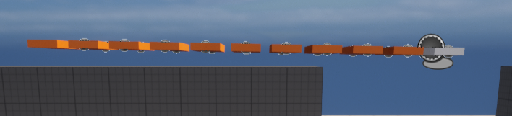
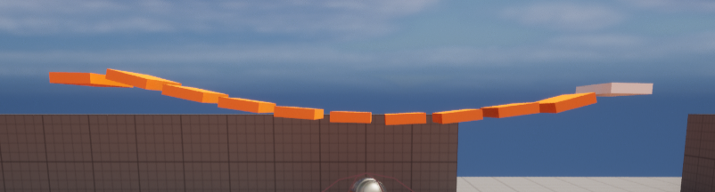
Physics Testing
Testing was carried out on a rope bridge and a jump pad but after the changes to the game had been made the development of these stopped

Slide 29
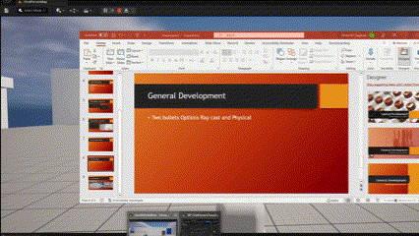
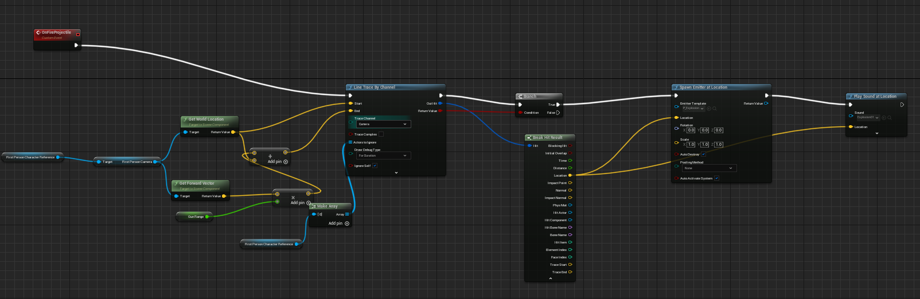
General Development
Two bullets Options Ray cast and Physical

Slide 30
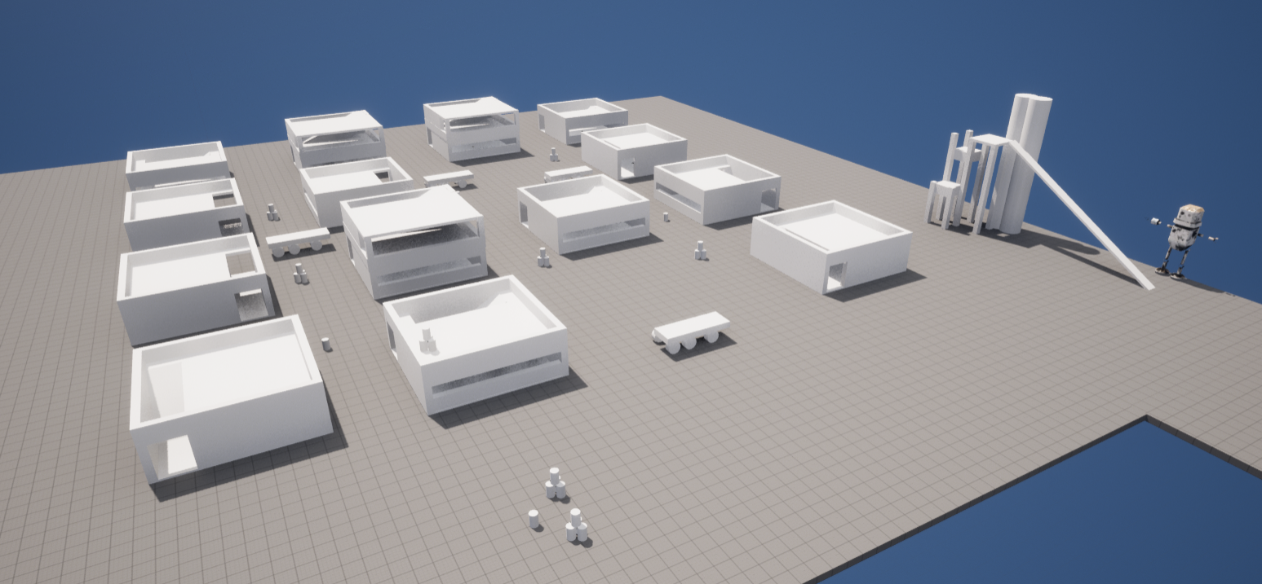
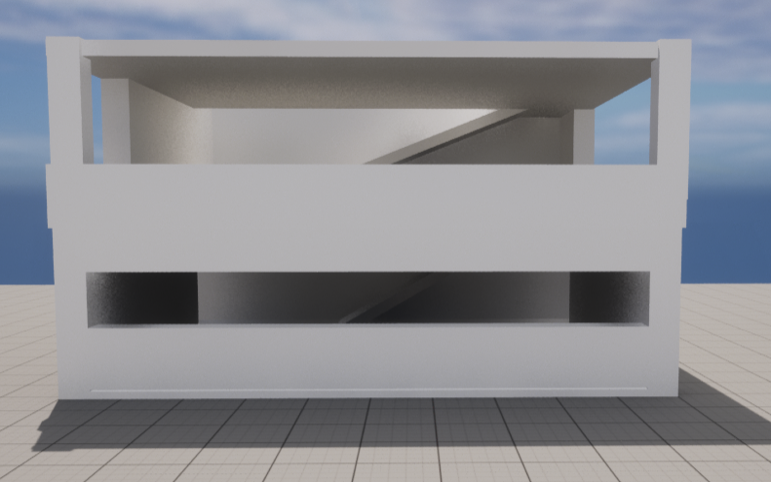
General Development
Early Map Creation Ideas

Slide 31
Omar Latreche
User Interface

Slide 32
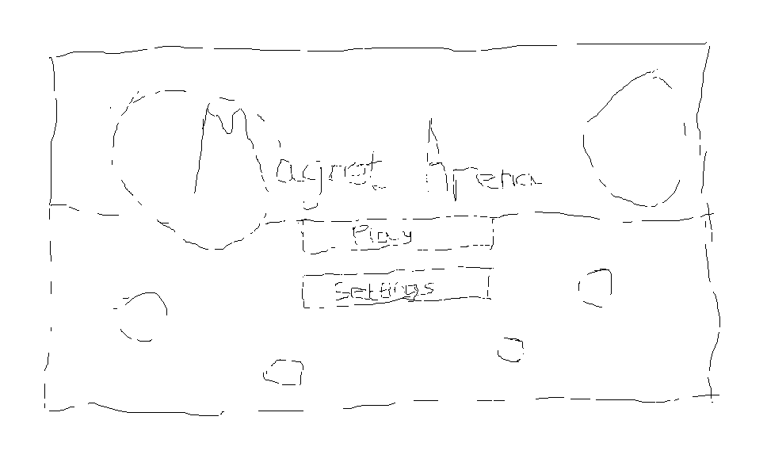
UI Specialism - Design Principles
Clarity and simplicity: Ensure that the UI is easy to understand, with minimal cognitive load for players. Use clear and legible fonts, icons, and colours to convey important information.
Consistency and feedback: Maintain a consistent visual language throughout the UI. Provide real-time feedback to the player's actions to enhance the gaming experience.
Flexibility and efficiency: Design the UI to adapt to various screen resolutions and input devices. Optimize the UI to reduce performance impact on the game.
Aesthetically appealing: Create a visually pleasing UI that complements the game's overall art style and theme.
[Image: Sketch of initial UI design Idea]

Slide 33
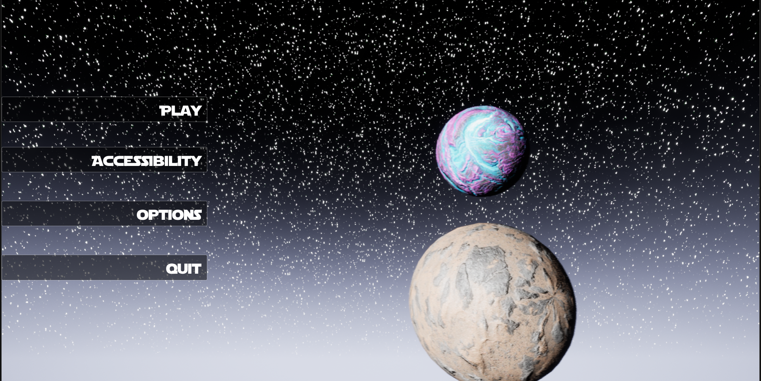
UI Components - Game HUD
Health and energy bars: Display the player's health and energy levels prominently on the screen, allowing them to monitor their status easily during gameplay.
Magnetic power indicators: Show the strength and direction of the magnetic fields generated by the player or the environment, providing crucial information for solving puzzles and overcoming challenges.
Interactive map and objectives: Present an in-game map with clearly marked objectives and points of interest, helping the player to navigate the game world.
[Image: Example of HUD]

Slide 34
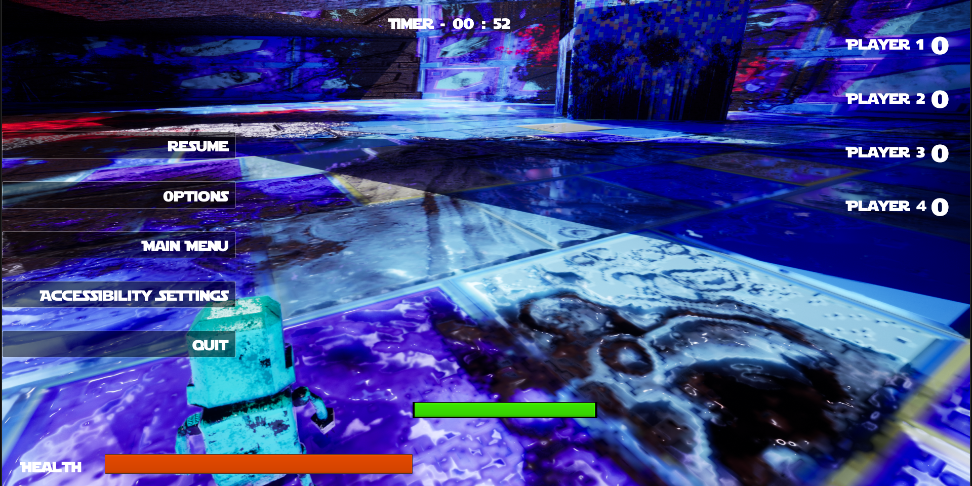
UI Components - Pause and Settings Menu
Intuitive navigation: Organize the menu options in a logical and consistent manner, enabling players to find and adjust settings with ease.
Responsive controls: Ensure that the UI responds quickly to player inputs, providing a seamless and frustration-free experience.
Customization options: Offer various settings for players to customize their gameplay experience, such as audio and video preferences, control schemes, and difficulty levels.

Slide 35
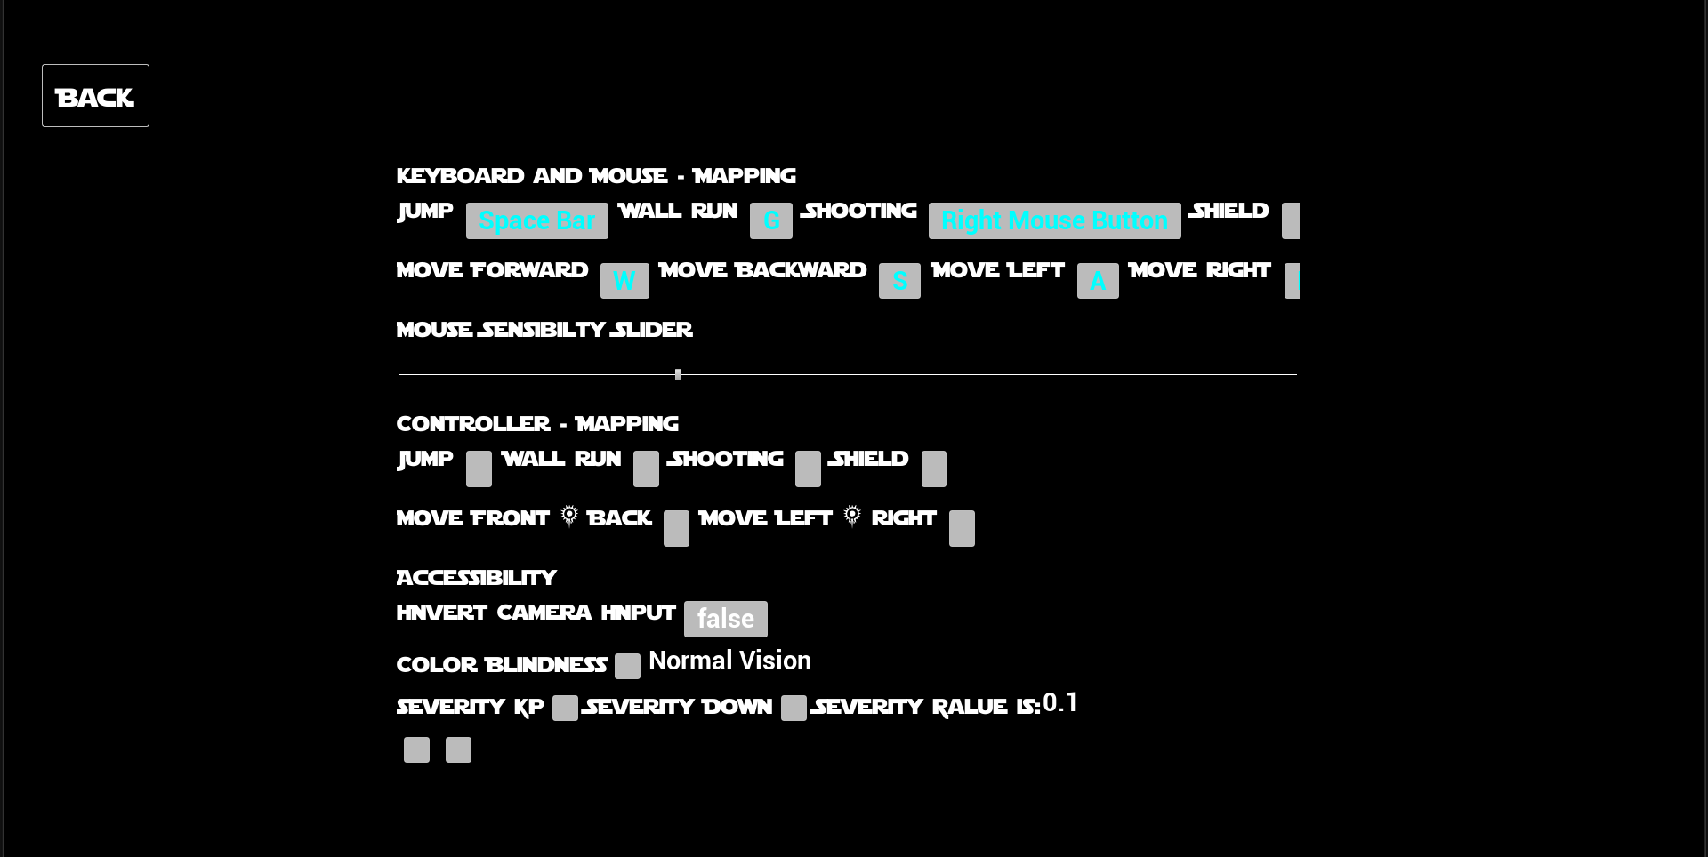
Accessibility Features
Colorblind-friendly options: Include alternative color schemes or icons to accommodate players with color vision deficiencies.
Adjustable text size: Allow players to increase or decrease the text size of the UI elements, ensuring readability for all users.
Customizable control schemes: Provide options for players to remap controls or adjust sensitivity settings, catering to their individual preferences and needs.

Slide 36
Iasmina Leagan
Networking

Slide 37

Specialism Implementations
Sessions
Host/Join a game
Spawn/Respawn
Player colours
Bullet damage
Health system
Additional (general):
Score system
Pressure plates
Moving platforms

Slide 38
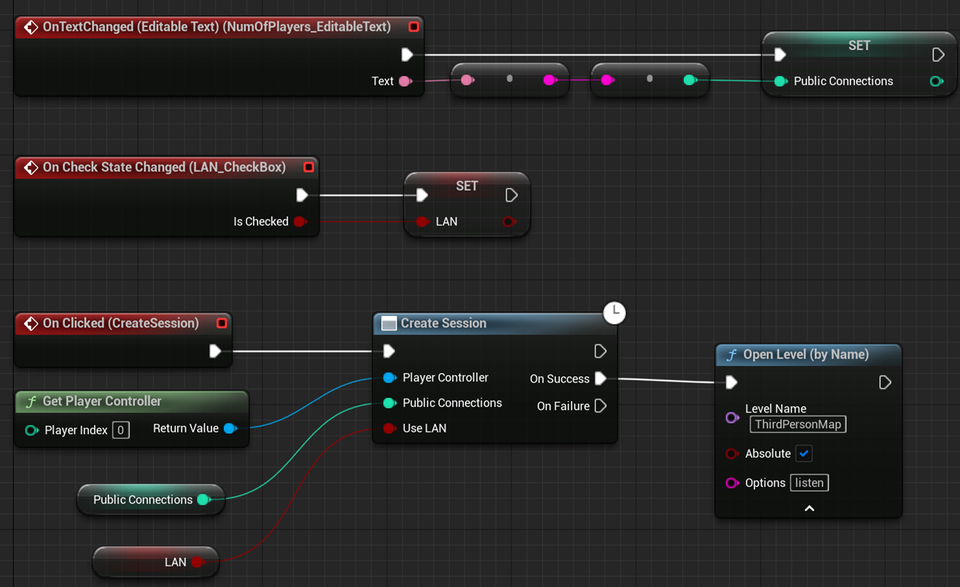
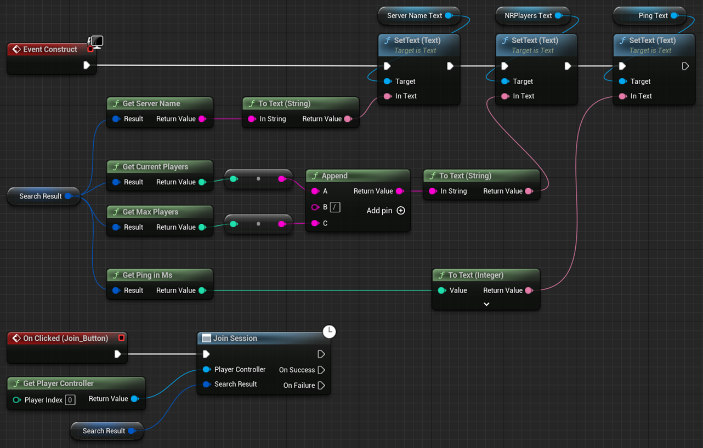
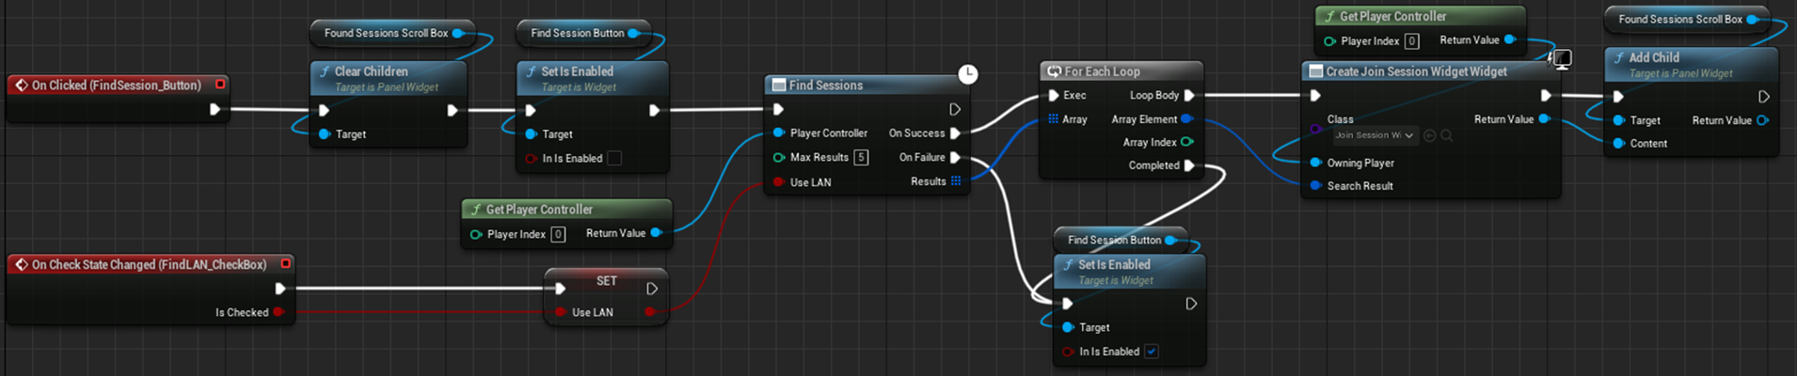
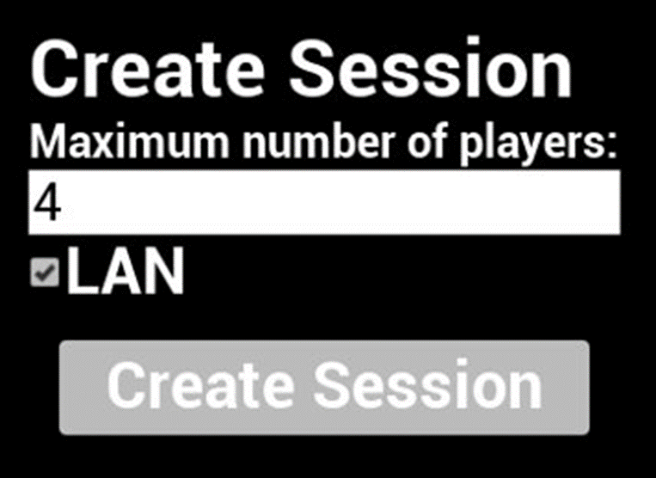
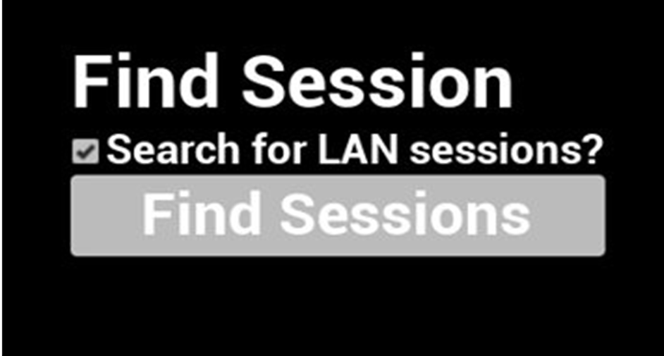
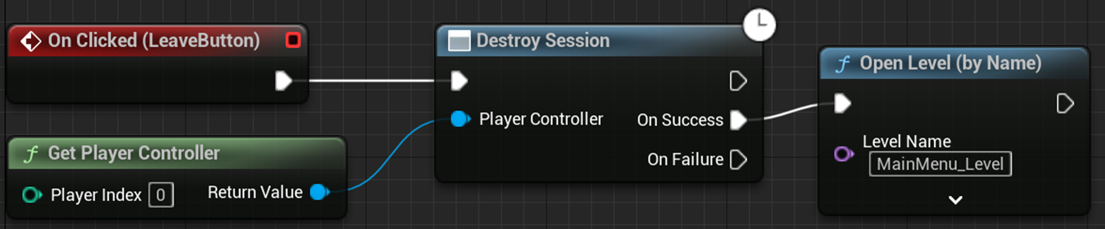

Sessions - rejected functionalities
Sessions were initially created with blueprints using subsystems and Unreal Engine's default system.
Multiple failed tests resulted in its rejection.
The reason could possibly be that the packet broadcast to the LAN's subnet was blocked.
Create Session
Join Session
Find Session
Initial Host/Join system
Delete Session

Slide 39



Updated Host/Join
This was done using C++ classes and Widget blueprints.
In the initial implementation, the players would spawn into a lobby and could host/join games using in-game console commands.
The final version does not use the lobby anymore, since the players connect directly to the map through user interface buttons; the join functionality also takes the host's IP address as an input. The functionality of the multiplayer part of the menu system was coded using C++ classes.
Initial Lobby using in-game console commands
Final version

Slide 40

Implementation using C++ classes
The functionalities use a custom Game Instance.
The host function uses "Server Travel" which:
Operates at world level;
Can be called at server level or engine;
Moves all participants.
The Join function uses "Client Travel" which:
Operates at player control level (called on PlayerController);
Tells the individual player controller to move (one at a time).
Additional: The Multiplayer Menu system uses an interface so that it can be attached to any other project; this uses a method called "Inversion of dependencies".
The Host and Join functions in the new Game Instance C++ class

Slide 41
Replication
How Unreal Engine handles replication:
Step 1 – The setting "Replication" must be turned on for each class so that the server has the ability to overwrite variables.
Step 2 – To update the server's variables to the clients, these must have one of the two configurations:
Replicated
RepNotify (ex: the player's colour)
Step 3 – The clients must use Remote procedure calls (RPSc), so they can communicate back to the server. There are 3 types of RPCs:
Run on Server (ex: applying damage)
Owning client (ex: updating the player's health for the health-bar)
Multicast – broadcasts an event on the server and all connected clients (but it is executed from the server)

Slide 42

Replication – necessary blueprints
Q: What can be replicated?
A: Everything except the GameMode (it only exists on the server) and widgets that only exist on the owning clients.
Server
Game Mode
Variables:
Array with connected players
Server & Owning Clients
Player Controller
Functions:
Spawn/Respawn
Server & Clients
Character (Pawn)
Widgets:
Health-bar
Variables:
Health
(Ammo, fire rate)
Functions:
Spawn projectile
Take damage
Timer
(Reload)
Server & Clients
Player State
Variables:
(Player name, username, ID)
Server & Clients
Game State
Variables:
Player scores

Slide 43

Replication – Game Mode
The GM contains all the classes that define the rules and logic for the game.
When each player connects, a copy of their Player Controller is stored in an array. This gets updated when the players change levels or disconnect.
Storing the connected players in an array

Slide 44



Spawn/Respawn
Random spawn point (Game Mode)
The Pawn (character) is not set in the world setting "Default Spawn Class" because the player is spawned through code for the respawn system.
The Game Mode contains two functions:
The first one gets a random location to spawn the player;
The second one Spawns the Pawn, but this pawn needs to be controlled by a PlayerController, therefore it gets assigned through a function called "Possess".
Although the spawn function is on the Game Mode, the Player Controller is actually the one calling the function to spawn it.
Spawn function (Game Mode)
Spawn function (Player Controller)

Slide 45


Replication – Different colours for players
The colour of the player's material is stored in a RepNotify variable, which is set only by the server, since it has authority.
The OnRep_Colour function is called each time the variable changes and it takes the colour and assigns it to the Pawn's material.
Setting a random colour
OnRep_Colour

Slide 46


Replication – Bullet + Health
Using Overlap functions, if the bullet collided with a Pawn, a function is called on the Pawn to decrease the health.
Also, the bullet checks the name of person who spawned it to avoid dealing damage to themselves.
The logic happens on the server to make sure all clients sync, but the value is further transmitted to an "Owning client" type function, which updates the specific health-bar UI of that player.
Calling the dmg function on collision (inside bullet actor)
The "receiving damage" logic (inside Pawn)

Slide 47



Additional features
A moving platform object that moves in between 2 points. This is replicated so that all players can see it moving.
A pressure plate (C++ class and blueprint inherited from it) that activates the moving platform (it can be used for future team collaboration mode).
Using OnOverlap events to move the platform
Setting the replication so that all clients can see the object moving
Code to make the object move

Slide 48


Additional functionalities - Score system
Whenever a bullet hits a player, it checks if their health is less or equal to 0.
If this is true, it checks who shot the bullet using the Instigator and assigns them a point.
All points are stored in the Game State, which can be accessed by the server and the clients.
Score update if target is killed
(in Bullet actor)
Updating player scores
(on Game State)

Slide 49
Rejected functionalities and future implementation
Rejected:
Sessions
Future:
The players spawn into a lobby system instead of directly in the game
They all get connected once a specific number of players connected
Countdown before spawning a player
The timer should be moved into the Game State

Slide 50
References
Planets Textures - https://substance3d.adobe.com/assets/allassets/7145ed862594a618610d6efba6a07776b337d85f?assetType=substanceMaterial&assetType=substanceAtlas&assetType=substanceDecal&q=planets%20major_planet%20satellite%20planet%20sci%20fi&u=planet%20sci-fi
Sound Effects from www.Pixabay.com & www.FreeSounds.com

